Slide 1
두두아이티-한동대SW중심대학 보안 실습 캠프
김 윤 정/ ㈜ 두 두 아 이 티
yjkim.87@duduit.co.kr
2021. 12.

Slide 2

네트워크 보안 # 1. Smurf Attack Detection and Response

Slide 3

네트워크 보안 # 1. Smurf Attack Detection and Response
A. Overview
We can detect and respond to a Smurf attack
B. Lab Environment
Attack Server (Kali-Linux) + Victim Server (CentOS 6)
Notes:
LAB overview is like this.
We can detect and respond to a Smurf Attack
The lab environment is consisted of Attack Server and Victim Server.
The Attack Server is Kali-Linux and the Victim Server is CentOS 6.0

Slide 4
네트워크 보안 # 1. Smurf Attack Detection and Response
C. Attack Type (Characteristics)
Smurf or Smurfing attack is carried out by exploiting the characteristics of the IP (Internet Protocol) and ICMP (Internet Control Message Protocol). ICMP allows you to use a Ping command to find out which nodes are currently running on the network.
When any node, which is running on, receives a Ping message, it transmits an Echo message to the source of the ICMP packet (Ping message).
The Smurf attack uses this action to change the Ping message to the victim's IP address and broadcast it to each router.
As a result, the victim causes a massive amount of Echo messages, causing the network to cause a Denial of Service (DoS).

Slide 5
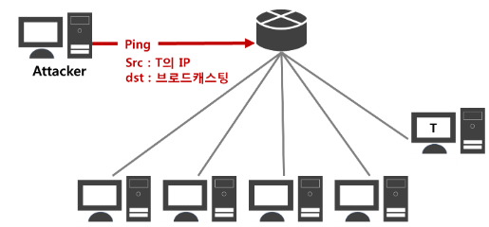
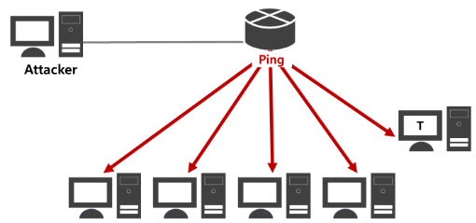
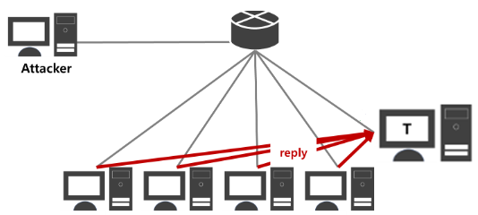
네트워크 보안 # 1. Smurf Attack Detection and Response
Attacker changes its IP to IP of T (target) and sends a Ping messge to the network to which the target belongs.
ICMP Echo Request is sent to all hosts to which the target belongs.
All hosts receiving the ICMP Echo Request send a response packet to the target.

Slide 6
네트워크 보안 # 1. Smurf Attack Detection and Response
E. Symptom
The network of the victim server is unstable or paralyzed
Notes:
This lab’s Symptom is that The network of the victim server is unstable or paralyzed
The Attack Method, Detection and Response method is shown in the following slides.

Slide 7
네트워크 보안 # 1. Smurf Attack Detection and Response
H. Lab Tasks
Currently, attackers are causing network traffic through the Smurf (Smurf) attacks. Block attacks by disabling responses to ICMP Echo Request Broadcast
Notes:
The Lab task is that …
Currently, attackers are causing network traffic through the Smurf (Smurf) attacks.
Block attacks by disabling responses to ICMP Echo Request Broadcast

Slide 8
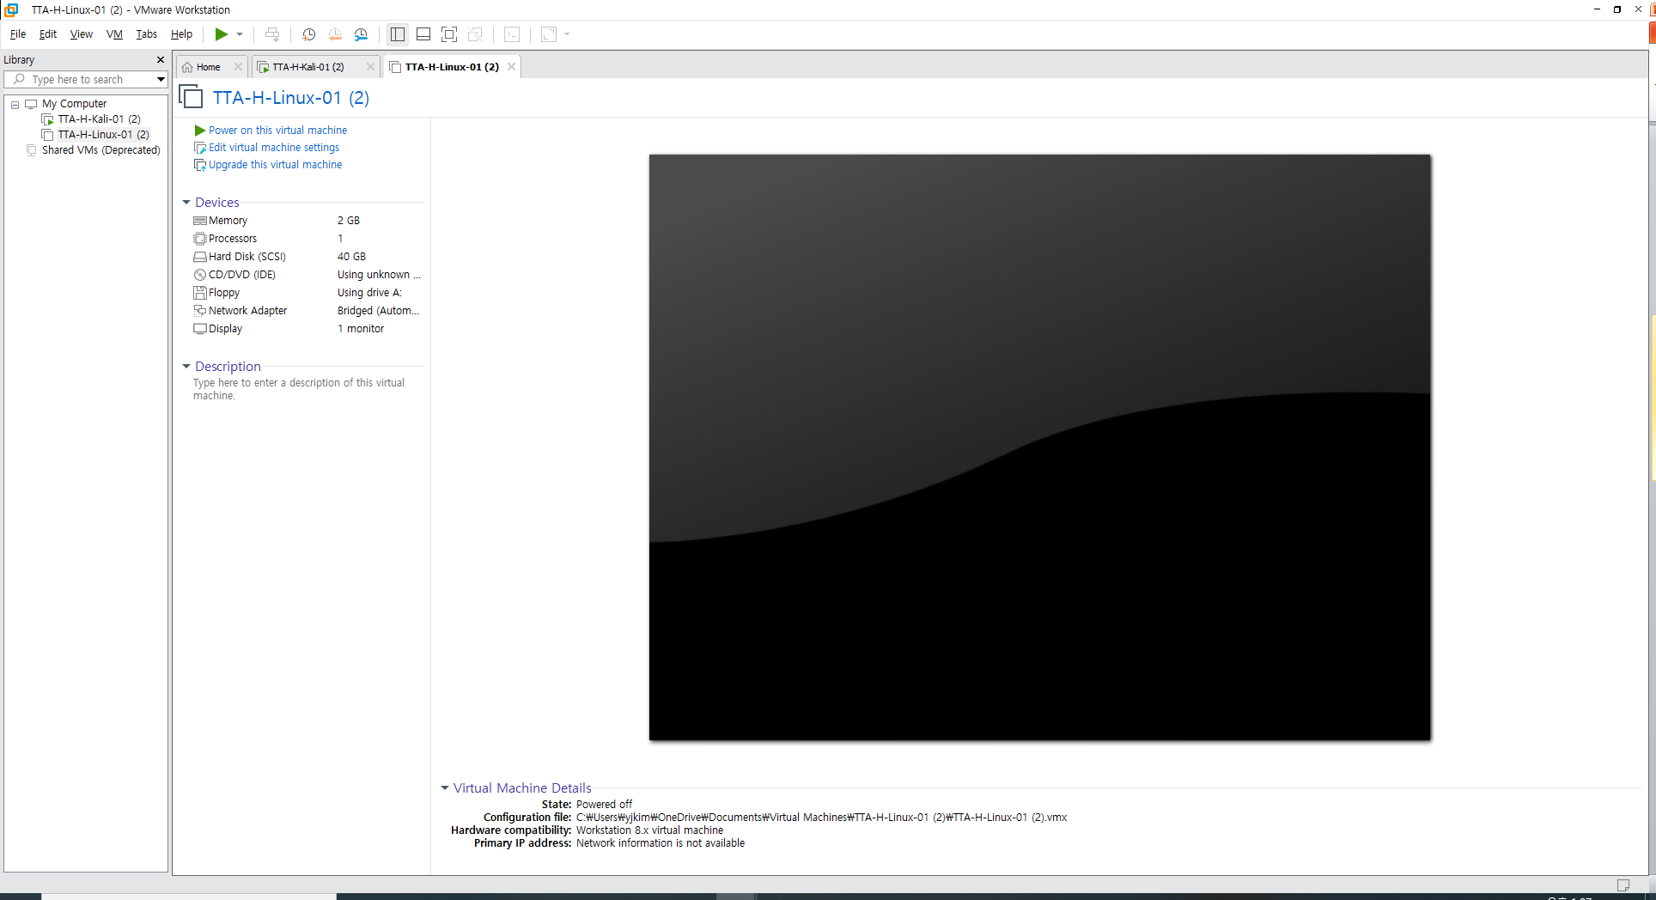

네트워크 보안 # 1. Smurf Attack Detection and Response
Solutions
Notes:
For the Lab,
You may connect to CyberAegis site with your account,
or Use VMWare Workstation Pro.

Slide 9


네트워크 보안 # 1. Smurf Attack Detection and Response
Attack Server (Kali-Linux)
Victim Server (CentOS 6)
The lab environment is consisted of Attack Server and Victim Server.
The Attack Server is Kali-Linux and the Victim Server is CentOS 6.0

Slide 10
네트워크 보안 # 1. Smurf Attack Detection and Response
Attack Server (Kali-Linux) account: root / toor
Victim Server (CentOS 6) account: root / root123
The Attacker Server’s account is root
And the password is toor.
The Victim Server’s account is root
And the password is root123

Slide 11
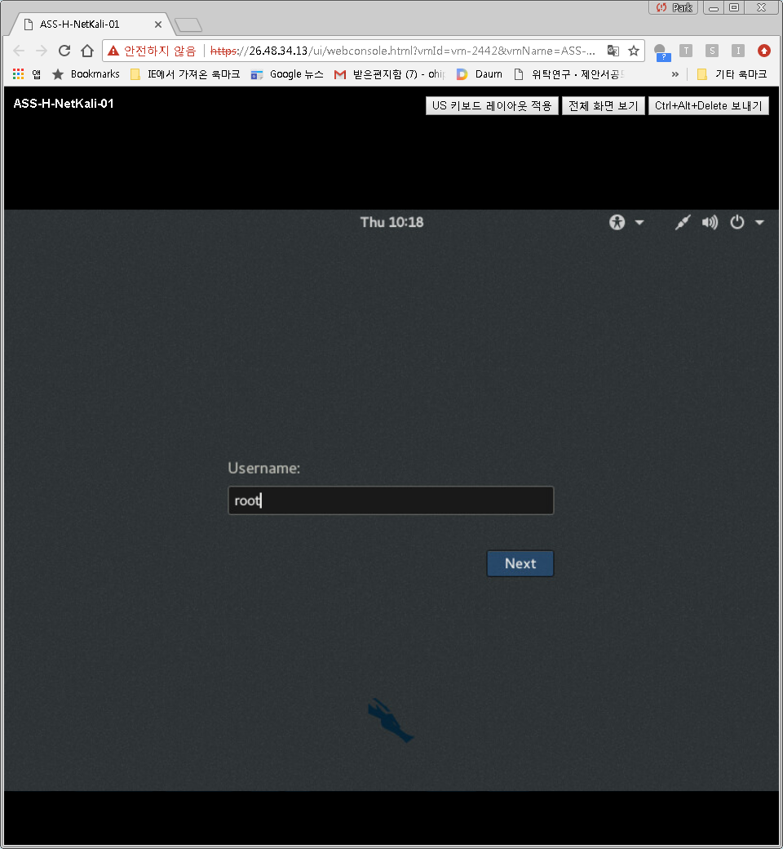
네트워크 보안 # 1. Smurf Attack Detection and Response Solutions
1) [Attack] Login to the Attacker Server
Notes:
The first step of LAB is initiated by attacker in Attacker Server.
You, as the attacker, login to the server.

Slide 12
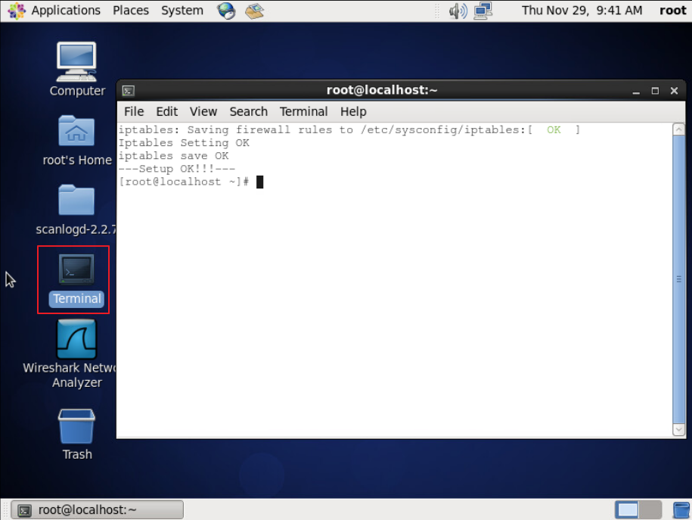
네트워크 보안 # 1. Smurf Attack Detection and Response Solutions
2) [Defense] Log in to the victim server and run Terminal
Notes:
This step, on Victim Server, login and run Terminal. The Terminal is executed by clicking the terminal icon.

Slide 13
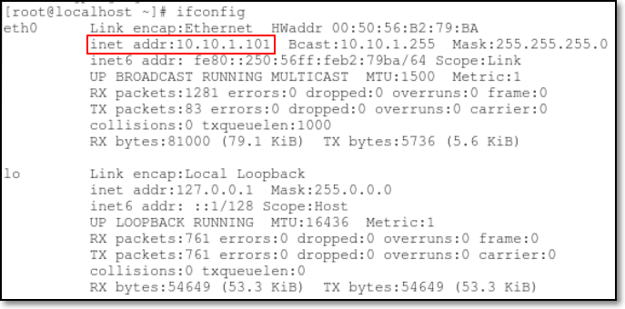
네트워크 보안 # 1. Smurf Attack Detection and Response Solutions
3) [Defense] Identify the IP address of the victim server to be attacked
Notes:
Using ifconfig command, you identify the IP address of the victim server.

Slide 14
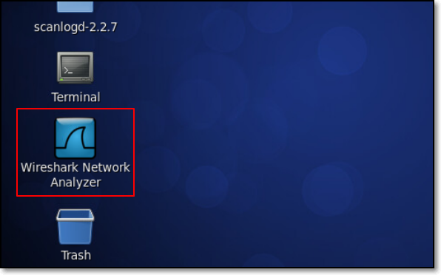
네트워크 보안 # 1. Smurf Attack Detection and Response Solutions
4) [Defense] Run Wireshark on the victim server to detect attacks in real time
Notes:
Now, run WireShark on the victim server.
This is for detecting attacks in real time.

Slide 15
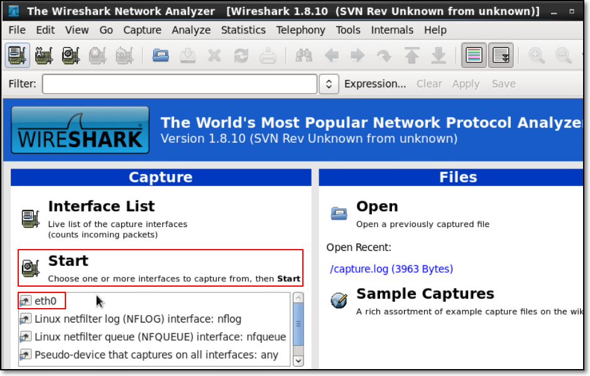
네트워크 보안 # 1. Smurf Attack Detection and Response Solutions
5) [Defense] Select eth0 and then Start
Notes:
Select eth0 as the interface and click start menu. Now, packet capturing is started

Slide 16
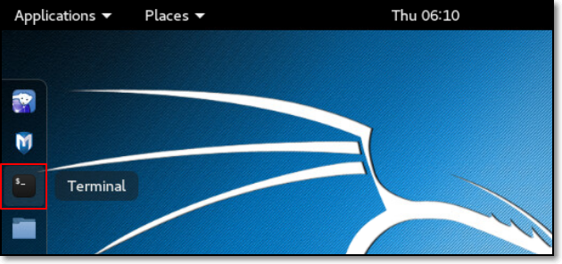
네트워크 보안 # 1. Smurf Attack Detection and Response Solutions
6) [Attack] Run Terminal on Attack server.
Notes:
On Attack Server, run Terminal.

Slide 17
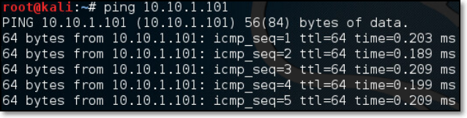
네트워크 보안 # 1. Smurf Attack Detection and Response Solutions
7) [Attack] Check the network connection with the victim server through the ping test.
# Ping [Victim server IP]
Notes:
In step 1, you logged in as an attacker.
The work of this step is ping. Ping checks the network connection with the victim server.
As shown in the terminal screen, Ping is done successfully; (the victim server can be reached)

Slide 18
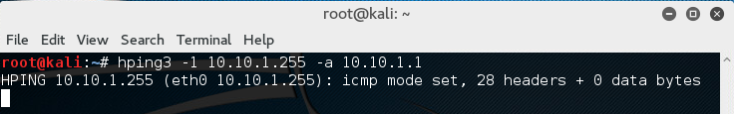
네트워크 보안 # 1. Smurf Attack Detection and Response Solutions
8) [Attack] Smurf attack is performed using the Ping command from the attack server.
# Hping3 -1 [broadcast address of the network being attacked] -a [router IP address of the network];
Notes:
Smurf attack is performed using the Ping command from the attack server.
‘Hping3 -1 ‘broadcast address being attacked’ –a ‘router IP’’, here -1 means ICMP mode.
The manual of kali linux’s hping3, you can get here - https://tools.kali.org/information-gathering/hping3

Slide 19
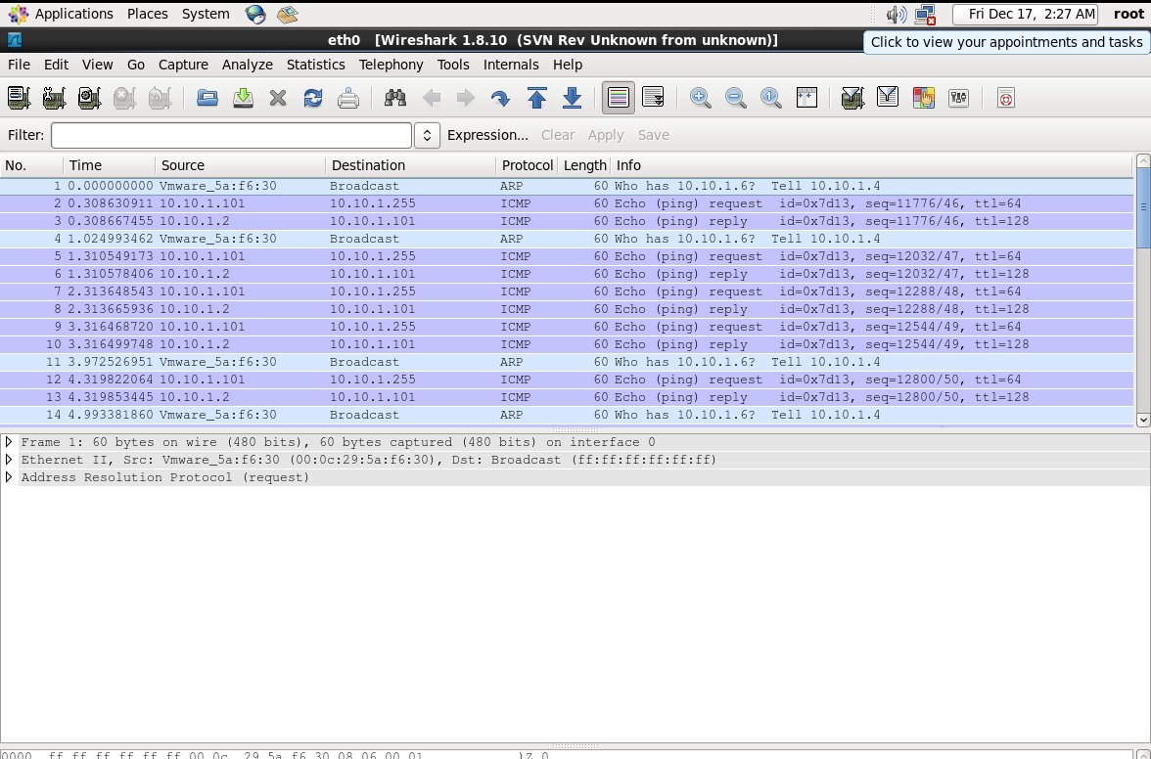

Slide 20
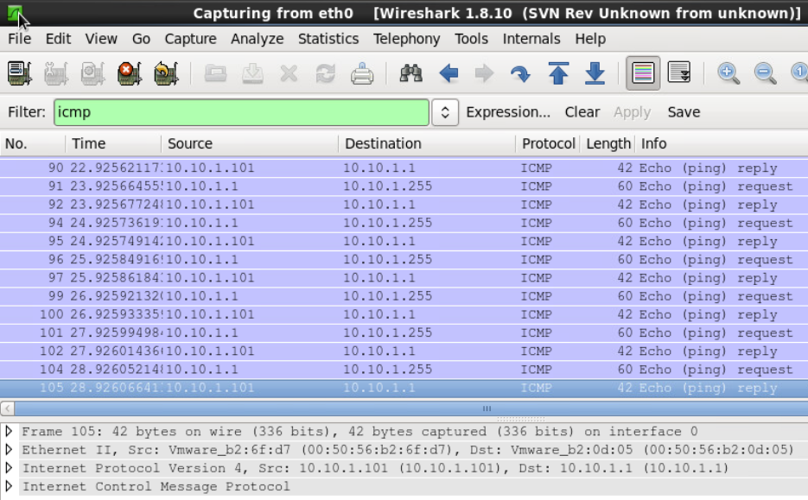
네트워크 보안 # 1. Smurf Attack Detection and Response Solutions
9) [Defense] Check the ICMP packet with the broadcast address as the destination via Wireshark at the victim server
Notes:
At the Victim server, check the ICMP packet with the broadcast address as the destination via Wireshark at the victim server

Slide 21
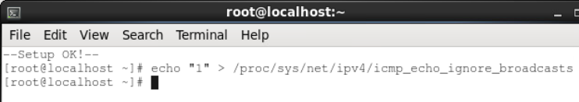
네트워크 보안 # 1. Smurf Attack Detection and Response Solutions
10) [Defense] Set the victim server not to respond to ICMP Echo Request Broadcast
# Echo "1"> / proc / sys / net / ipv4 / icmp_echo_ignore_broadcasts
Notes:
For defense, set the victim server not to respond to ICMP Echo Request Broadcast
‘ Echo "1"> / proc / sys / net / ipv4 / icmp_echo_ignore_broadcasts ‘ command do this.

Slide 22
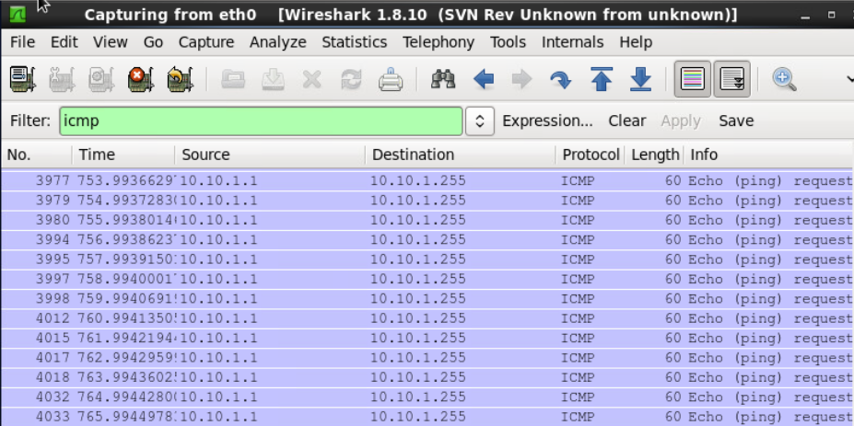
네트워크 보안 # 1. Smurf Attack Detection and Response Solutions
11) [Defense] After the Defense, the ICMP echo reply packet of the victim server is not seen
Notes:
After the Defense, the ICMP echo reply packet of the victim server is not seen

Slide 23

네트워크 보안 # 1. Smurf Attack Detection and Response Solutions
12) [Defense] check
- After the attack prevention, If you type the command # check, you can get the key code
Notes:
After the attack prevention, If you type the command # check, you can get the key code

